Slide 1

職場故事 (Animaze)
Notes:
https://pixabay.com/videos/man-working-laptop-character-146100/

Slide 2

目標
Notes:
https://www.istockphoto.com/en/video/businessman-hand-draw-rising-graph-business-growth-gm905422032-249655137

Slide 3

阻礙
Notes:
https://www.istockphoto.com/video/overcoming-business-challenge-and-obstacles-gm1867577728-552856057?utm_source=pixabay&utm_medium=affiliate&utm_campaign=SRP_video_sponsored&utm_content=https%3A%2F%2Fpixabay.com%2Fvideos%2Fsearch%2Fobstacle%2F&utm_term=obstacle

Slide 4
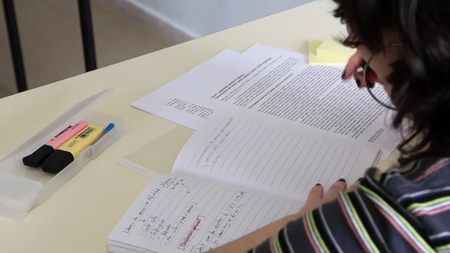
努力

Slide 5

結果
Notes:
https://pixabay.com/videos/lighting-thunder-storm-sky-166697/

Slide 6
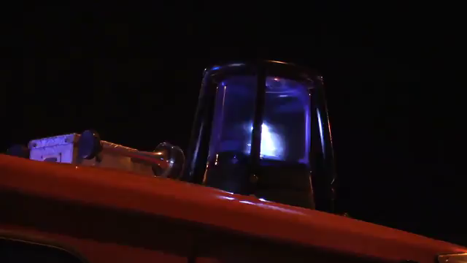
意外
Notes:
https://pixabay.com/videos/blue-light-fire-fighters-mission-7012/

Slide 7
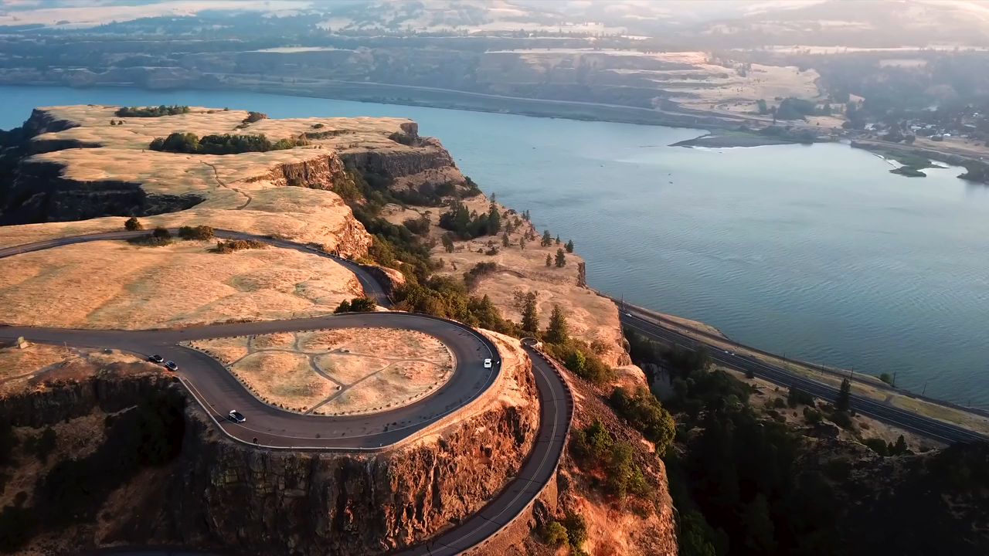
轉彎
Notes:
https://pixabay.com/videos/sunrise-viewpoint-landscape-nature-22609/

Slide 8

結局
Notes:
https://pixabay.com/videos/rainbow-sky-clouds-blue-background-21460/

